Slide 1
Data Discovery Workshop
Devika Nair, Research Scientist
Social and Decision Analytics Division
CLD3 Workshop – Leveraging Alternative Data Sources to Address Community Challenges
March 25-26, 2019
Notes:
Hello, it’s nice to meet you. My name is Devika Nair and this is my colleague Josh Goldstein. I am the newest addition to the SDAD team as a Research Scientist and I have had the great fortune to participate in a wide variety of projects and interact with a number of stakeholders during my time with the lab.
BACKGROUND –
MS Data Analytics
1 year - Arlington County – Process & Data Analytics Team
Last summer - DSPG fellowship –worked on projects with Virginia Cooperative Extension & Virginia Tech University
Today I am going to take us through the Data Discovery, Inventory, and Screening portion of our CLD3 approach to research. I have a few slides for us today, but this is a workshop, which means we’re going to spend the bulk of this session in exercises and discussions. And I will look to you for your questions, feedback, and ideas as we move through the presentation. Please help me make this an interactive session and feel free to interrupt me at any time!
,

Slide 2
Frame research by targeting a specific problem
Notes:
As Sallie mentioned, our project always starts with problem identification, which is such an important step of any research project. In my experience, as I’m sure happens with others, problem identification is rarely a solo act. Almost any policy question you want to ask is going to involve a good number of inputs and stakeholders. You might want to talk to subject matter experts, people who administer services, and residents affected by policy. You may also need to consider resources, timeline, and broader strategic priorities. Problem identification in the world of local government is often complicated, so specificity is key.

Slide 3
A well-stated problem is a problem half-solved
Example:
Consider USDA’s Rural Utilities Services division, which administers programs that help to fund and set up broadband in rural areas. They’ve been running a number of programs over the last few decades, but lack insight as to how their programs have impacted residents. Because USDA RUS is launching a new broadband program, measuring impact of previous programs is critical to the development and implementation of an effective new program.
Identifying and defining a research problem is key to the effectiveness of the work.
Concise
Clear
Specific
Outcome-driven
Dynamic Work Simplification (1971) by W. Clements Zinck, p. 122
Notes:
Charles Kettering – American engineer and inventor, head of research at GM for 25 years.
”A problem thoroughly understood is always fairly simple.”
Put another way, the time invested in understanding the context of a problem, all the forces and people at play, and where a gap really lies – is in and of itself part of the solution.
When pondering our own research questions to draw up problem statements, there are a few things we need to keep in mind:
Problem statements should be
Concise - communicable in 1-2 sentence
Clear
Specific
Outcome driven – the problem defined is ultimately attached to an action, a decision, an outcome
I’ve put down a quick example from one of our current projects here, where our team is partnering with ERS. I’ll give everyone a minute to quickly read the example.
PAUSE do we have a clear and concise one? How could we focus?
..
So in this example, we are looking to measure impact to people from broadband access. And that is directly going to shape our literature review…

Slide 4

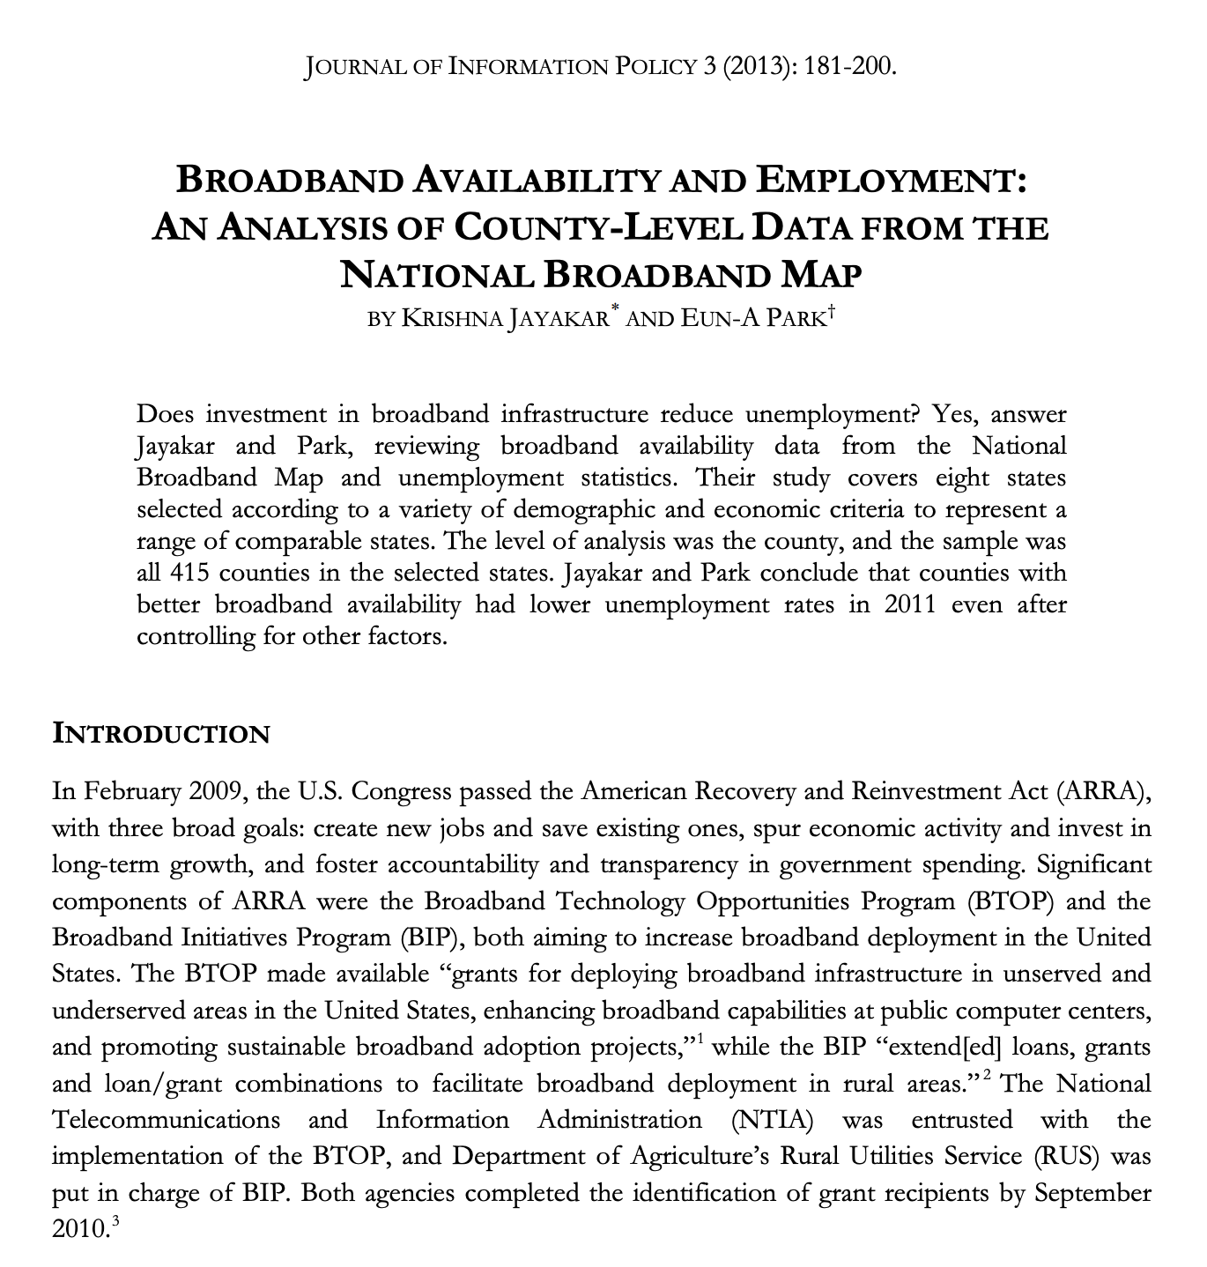



Project shaped by problem statement
Notes:
We begin to see how that problem statement affects the project when we launch into the literature review. Here we see that there is a breadth of research investigating how broadband affects people, but our problem statement didn’t say what kinds of impact the project sought to measure. So we have here many articles on economic impact and employment, but the trap you could quickly fall into is spending a lot of time on a project direction, only to find that your stakeholder or community was interested in something else entirely. In this case, ERS was very much interested in the economic impacts, but they were more specifically interested in impacts to the real estate market, as given by property values, which the above literature would have missed.

Slide 5
Data pipeline starts with data discovery
Notes:
So once we’ve narrowed down our problem statement, and come to an agreement upon reviewing the literature and discussion with all our relevant stakeholders, we next step into the data discovery phase of the project.

Slide 6
Data discovery process and definitions
Dataset Idea
Dataset Idea
Dataset Idea
Project’s Data Assets
Data Inventory
Data Discovery is the open-ended and continuous process by which candidate datasets are identified.
Data Inventory refers to the broadest, most far-reaching ‘wish list’ of information pertaining to your research question.
Data Screening is an evaluative process by which eligible datasets are sifted from the larger pool of candidate datasets.
Data Acquisition is the method of physically acquiring the data, which can involve cooperative or purchase agreements, web-scraping, file-transfer protocols.
Data Discovery
Data Screening
Data Acquisition
Notes:
Let’s start with an overview and the terminology, as our group defines these phases.
The overall process of data discovery is an open-ended and continuous one, where you and your team both upfront at the start of the project and throughout its life, are identifying information and candidate datasets that would be informative to your research.
This discovery process results in a wish list – and we call that wish list our inventory. It’s the broadest, most far-reaching list of sources. Here you want to dream the impossible dream, and put down anything and everything that relates to your questions. This means putting down
- datasets with pricetags (ex. LexisNexis, a repository of legal writings and news sources)
- information that might not be available to you (ex. Student PHI)
- information that doesn’t exist! (ex. dog-walking routes of town residents)
The point of the inventory is to put down ideas, all your ideas, even if you do not use all of them. We’ll talk more about why on the next slide… but
Moving on, we have data screening, which we perform in two-three phases. Data screening is the process by which you distill your meaningful dataset ideas from the larger pool of candidates in the inventory. This process could very well look different for different organizations and have different features for different projects.
Through that screening process, you are going to sift out the datasets you will target for data acquisition – the method by which you physically acquire the data. Maybe you scrape this data, maybe you sign an agreement for a research partner to share it with you, maybe data is publicly hosted online and can be downloaded by a file transfer protocol.
Overall this process gets you thinking about the wider universe of information and what is realistic for your project.

Slide 7












Benefits and challenges of data discovery
Benefits
Timeliness
Lower Cost
Larger Samples
Geographical Granularity
Longitudinal Tracking
Challenges
Identifying relevant data
Evaluating data applicability
Selecting data sources
Acquiring data
Assessing quality
Outcome
Richer sources
Informed project vision
Accessing Alternative Sources of Data for Education Research. Ziemer, Shipp, et al, 2016.
Notes:
Now there are benefits and challenges to our data discovery process.
On the benefits side, you are looking at better data resources in terms of time, cost, size, and geography because you spent the time considering everything. You’re better positioned to make informed choices on all of these counts, because you have a list of documented data sources you can go back to.
On the challenges side, the process can seem overwhelming because it requires time up-front to review and determine whether a dataset is of interest and whether it works for a project.
CLICK
But I think of it this way – you only have to screen and document a dataset once but having that documentation now enables you to have a list of sources that you can use
- for other projects
- to defend your choices on project direction, methods, and data
- partner with others to access
And most importantly, you are starting your project with a more informed project vision, for having thought through all the various possible inputs.

Slide 8


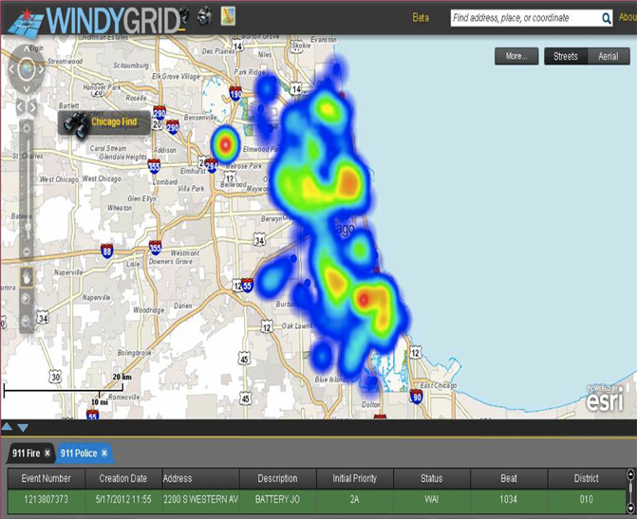

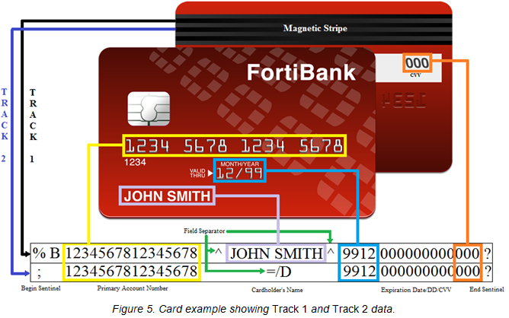

Data Discovery – inventory considers all sources
Local, State, and Federal
Designed Data
Administrative Data
Opportunity
Data
Procedural Data
Census surveys
CDC surveys
BLS surveys
NCES surveys
Birth records
Tax records
FCC Data
GPS
Social media
Farm Bill
Supreme Court Rulings
Legal briefs
Designed Data Collections
Statistically designed data collections, such as surveys or experiments, and intentional observational collections.
Administrative Data
Data collected for the administration of an organization or a program.
Opportunity Data
Data generated on an ongoing basis as society moves through its daily paces.
Notes:
Data Discovery does not discriminate based on source (other than illegal hacking, of course). This phase should consider ALL possible sources.
Designed Data: data created with a pre-specified purpose and use in mind
Examples:
CDC – National Health Interview Study
NCES – Early Childhood Longitudinal Study - three longitudinal studies that examine child development, school readiness, and early school experiences.
Administrative Data: data collected for recordkeeping, not research purposes
Examples: birth records, taxes, FCC data
Pros: large files, informative about programs, regularly updated, already exists (don’t need to collect), accurate
Cons: no control over available variables/measurements, historical records not always retained, messiness, may not be merge-able with external data
Opportunity Data: data collected through the mechanisms of everyday life
Example: GPS, social media, wearable devices,
Procedural data: data derived from policies, procedures, and legal requirements
Example: Farm Bill, Supreme Court Rulings, state constitutions
Sources:
https://www.census.gov/newsroom/blogs/director/2011/05/designed-data-and-organic-data.html
https://www.summitllc.us/blog/what-is-administrative-data
https://www.ringdna.com/blog/contextual-sales-data-matters-most-to-sales
https://discoverorg.com/blog/predictive-intelligence-black-box/
https://www.esri.com/en-us/maps-we-love/gallery/open-opportunity
https://opportunityinsights.org/data/
https://opportunityinsights.org/data/
Rabbitholes:
Opportunity Data: data collected on consumer wants and what sales opportunities might fit their needs (sales-oriented data?)
Market Research companies and econ (?) companies have different definition
DiscoverOrg: leadership change, funding granted, pain points, HR plans (promotions, layoffs), company events, mergers, FCC fines
RingDNA: social data harvested from social media
ESRI: map called “Open Opportunity Data” – the financial feasibility of moving to a zipcode.
Opportunity Insights: socio-economic opportunity
Procedural data: data generated algorithmically
Example: video games

Slide 9
Examples of Data Discovery Arlington County, VA & Food Insecurity
Community Organizations
Identify local community organizations and characterize role in food security
Review food & beverage nutrition standards for community programs
Neighborhoods & Parents
Characterize neighborhoods and families by income, education levels, and food security;
Identify vulnerable populations across neighborhoods;
Determine income dynamics at play
School Districts
Characterize school district access to healthy, balanced, nutritious food;
Determine uptake of these programs and services
Local Government
Locate areas and neighborhoods most vulnerable to food insecurity
Study role and impact of current social programs in food security
Determine safety of walking environment
Notes:
So I want to walk through some examples of how this data discovery process can be useful for us. Sallie had mentioned one of our projects on childhood obesity with Fairfax County, but I want to walk through how this would play out with a similar but related problem. Let’s say our team was tasked with studying food insecurity in Arlington County, our surrounding jurisdiction.
In our early discussions on this project, we want to brainstorm all the stakeholders, entities, and spaces across which this idea of food insecurity is playing out. And in this case, we come up with four high level groups of entities: community organizations, local government, neighborhoods and families, and school districts. Each of these areas represents a different informational component of the research. We can use these four areas as a way to organize ourselves and prioritize research areas as we move throughout the project.
NEXT

Slide 10
Examples of Data Discovery Arlington County – Food Insecurity
Federal Surveys
American Community Survey (demographics, income, …)
Current Population Survey, Household Food Security Survey Module (HFSSM)
NCES The Early Child-hood Longitudinal Study-Kindergarten (ECLS-K) Cohort
NHANES III
Panel Study of Income Dynamics (PSID), using data collected in 1999, 2001, and 2003
Survey of Income and Program Participation
Consumer Expenditure Survey
Neighborhoods & Parents
Characterize neighborhoods and families by income, education, and food insecurity levels;
Identify vulnerable populations geographically across neighborhoods;
Determine income dynamics at play
School Districts
Characterize school district access to healthy, balanced, nutritious food;
Determine uptake of these programs and services
Notes:
So starting with neighborhoods and families, our goal is to characterize Arlington County by its resident population and understand who these families are at baseline, perhaps by income and education and their vulnerability to food insecurity.
From there, we can start to map the high level pieces of information to real data sources, like the American Community Survey – which gives us a sense of demographics and income. We might also leverage the Current Population Survey, which includes a module on household food security. PERFECT!
Now that we’ve taken the time to understand our baseline population, we want to start looking at those providers of food security, and we’re going to build on the families we have been profiling by looking at school districts next.
On School Districts, we’re looking to characterize children’s access to food, ideally healthy food, and determine the utilization of these services. Mapping that back to administrative data, we might see this represented by the Early Childhood Longitudinal Study with their Kindergarten cohort.
NEXT

Slide 11
Examples of Data Discovery Arlington County – Food Insecurity
Community Organizations
Identify local community organizations and characterize role in food security
Determine locations of service and utilization of services
Nonprofit Associations
Feeding America
Meal on Wheels Association
National Foundation to End Senior Hunger
IRS List of Nonprofit organizations by area
Local data
USDA food deserts
Community gardens, soup kitchens, etc.
Social Innovation programs
Other local data
Local Government
Study role and gaps associated with current social programs aimed at hunger relief
Determine locations and characterize extent of food deserts
Identify opportunities in state programs
Notes:
Continuing in that vein, there are other providers of food security that we wawnt to look at: community organizations and local government. With both of these, we want to characterize the role, the extent, and the gaps of these services, and there are some options across local, opportunity, and administrative data.
For example, there are a number of nonprofits active in our area whose posted routes or service locations we might pull into our analysis. The IRS has a list of non-profits by area, so that administrative dataset may help us find nonprofits we may have missed by websearch or stakeholder conversations. USDA has resources around food deserts that might be helpful.
Really here, what I want to drive home is the importance of starting the data discovery process with desired information and then mapping those to data sources. What quickly emerges is a list of potential data sources, and while it’s tempting to run off with your source list, it’s reallllly helpful to compare your information list to your data list and think about the limitations and assumptions of your research as well as what you are missing. And that leaves you in a better position to defend your project direction choices and upon project completion, go back and pick up a new direction.
NEXT

Slide 12
Examples of Data Discovery Arlington County – Food Insecurity
Internal Factors
Food Insecurity
External Factors
Food insecurity
Demographics (age, race, ethnicity)
Socio-Economic Status (income, education, occupation)
Environment (household size, region, urban or rural)
Household composition (single parents, children, elderly)
Disabilities
Food deserts
Support Programs
Indicators
TANF, SNAP, WIC, National School Lunch Program
Summer Electronic Benefits Transfer for Children
Food banks, meal deliveries, soup kitchens
Community gardens
Social innovation programs
School system monitoring systems
Social networks
State & Federal
RV-ARC
City & County Programs
Households
Consequences
Chronic illness
Obesity, hypertension, diabetes
Stigma, depression
Physical & cognitive development
Spending tradeoffs
Social Impacts
Increased health care
Poverty
Unemployment
Inequality
Lack of access to social capital
Vulnerable Populations (Adults, Children, Elderly)
Notes:
Ultimately, we would compile the results of our data discovery into a data map, that visualizes the domains and data we hope to leverage for our research question. Here you can see the information is organized in a number of different ways. First by internal and external drivers of food insecurity.
Internal side, you see the risk factors for food insecurity as well as the consequences.
External side, you see the organizational efforts to address hunger relief as well as the social impacts of food insecurity.
Both - there are data points and data sources that inform our work at multiple levels of analysis, as given by our system of closed venn diagrams at the center.
At the state level, we have statewide unemployment from our social impacts domain.
City and County programs are at play in the support programs, like the local food banks.
Households are shown in the indicators, with components like Demographics nad Household Composition.
And Vulnerable Populations are given in the individual consequences, like chronic illness.
NEXT

Slide 13
Data Discovery – shaped by problem statement
Problem Elaboration
Objective: We want to define and quantify impact of federally-funded broadband programs in rural areas.
Background: Consider USDA’s Rural Utilities Services division, which administers programs that help to fund and set up broadband in rural areas. They’ve been running a number of programs over the last few decades, but lack insight as to how their programs have impacted residents in terms of property values. Because USDA RUS is launching a new broadband program, measuring impact of previous programs is critical to the development and implementation of an effective new program.
Problem: Today we have no information around the impact of our programs, successful or otherwise. If we ignore this problem, the $600B allocated to develop a new program may become wasted taxpayer dollars, spent in ways that do not benefit rural communities. We may lose the trust of the American people and lose the opportunity to fund similar initiatives in the future.
What themes emerge from the problem statement?
rural communities
program impact
property values
Broadband access
Designed Data Collections
Statistically designed data collections, such as surveys or experiments, and intentional observational collections.
Administrative Data
Data collected for the administration of an organization or a program.
Opportunity Data
Data generated on an ongoing basis as society moves through its daily paces.
Notes:
Now I want to return to our original problem statement. We have added in our piece about real estate and property values, and we are now pulling out our major themes. We have this idea of rural communities, program impact, property values, and Broadband access. We take these informational domains through our data discovery process and emerge with our data map.
NEXT

Slide 14



Data Map
Property values
Property factors
Value (land, improvement)
Location
Age (actual, effective)
Ownership/Rental
Size (acreage/sq footage)
Public infrastructure (roads/utilities)
Broadband factors
Availability
Number of providers
Type
Speed
Latency
Consistency
Adoption rate
Property factors
Value (land, improvement)
Location
Age (actual, effective)
Ownership/Rental
Size (acreage/sq footage)
Public infrastructure (roads/utilities)
Broadband factors
Availability
Number of providers
Type
Speed
Latency
Consistency
Adoption rate
states & regions
cities & counties
Housing factors
Construction activity
Zoning/land use restrictions
# homes for sale
# buyers
Neighborhood factors
Schools
Safety/crime indicators
Cultural institutions
Parks and recreation
Healthcare
Public transportation
neighborhoods
Development factors
Unemployment
Business & entrepreneurship
GDP (ag, mfr, forestry, …)
Income growth
Inflation rates
Commercial amenities
Infrastructure plans
Community demographics
Age distribution
Education distribution
Income/wealth indicators
Racial/ethnic composition
Community demographics
Age distribution
Education distribution
Income/wealth indicators
Racial/ethnic composition
property
Notes:
Because we’ve done such an excellent job with problem elaboration and have a very specific, clear, concise, and actionable problem statement, we’ve been able to flesh out three of the themes we had caught in our major themes as well as some other domains that may be of interest to us.
CLICK
And of those, we now have a sense of the types of information we need. Our broadband factors, like availability, speed, latency, are all datapoints we'll need and when we start to think through where we could find these data...
NEXT

Slide 15
Discovering Data
How to discover data?
Problem Statement Elaboration
Stakeholder Conversations
Industry
Meetups
Conferences
Research Organizations
University Libraries
Data Aggregators
Kaggle
Data.gov
Literature Review
Federal Statistical Agencies (13)
Personal & Professional Experience
When all else fails, GOOGLE!
Federal Statistical Agencies
Bureau of Economic Analysis
Bureau of Justice Statistics
Bureau of Labor Statistics
Bureau of Transportation Statistics
Census Bureau
Economic Research Service
Energy Information Administration
National Agricultural Statistics Service
National Center for Education Statistics
National Center for Health Statistics
National Center for Science and Engineering Statistics
Office of Research, Evaluation, and Statistics (SSA)
Statistics of Income (IRS)
Notes:
Using our data map, we now know what kinds of information we need and we’re going to set out to discover our sources. This process for me, always starts with problem statement elaboration, specifically in conversations with stakeholders.
Are there data they are already using?
Are there strengths or drawbacks to what they’ve been using?
What would be most informative to them given their day to day work?
Industry conversations can also be incredibly helpful. Hearing from and talking to people who work in either the data space or the specific domain can help illuminate useful sources. For us those conversations often happen at meetups, conferences, and with other research partners. Another useful and often undervalued source are university libraries, who often maintain data assets on behalf of their academic institution.
Data aggregators can also be helpful. Kaggle and data.gov are massive sites. We had a project looking to STEM educational pathways and found a site called credentialfinder.com that aggregated STEM credentials for us. You never know what’s out there!
Literature review can also be helpful, to find out what datasets others use.
There are 13 federal statistical agencies who host publicly accessible data themselves, which we leverage often.
Personal and professional experience is great. For our Broadband example, I was able to lean on my work with Arlington County

Slide 16
What relevant data exist in the wild? Example Data Inventory List
Rural Communities
American Community Survey (Census)
Quarterly Census of Employment and Wages (Bureau of Labor Statistics)
Small Business Administration
Program Impact
RealtyTrac (powered by ATTOM)
ATTOM
CoreLogic
Multiple Listing Service
Community County Business Patterns (Census)
American Housing Survey (Census)
National Establishment Time Series
Zillow / Trulia
Municipality sales data
Texas A&M Real Estate Center - housing activity - sales & volume dollars
Local open data
Broadband
BroadbandUSA.com (National Telecommunications and Information Administration)
National Broadband Map (National Telecommunications and Information Administration)
Form 477 (Federal Communications Commission)
Consumer Technographics® North American Technology, Media, And Telecom Benchmark (Forrester)
Consumer Technographics® North American Online Benchmark Survey, Part 2 and Part 1 (Forrester)
BroadbandNow.com
FiberLocator.com
Notes:
Using our data map, we have brainstormed our wishlist of data we are dreaming of. In each of these domains is a number of potential sources that could fit our needs.
For this project, we are looking to leverage federal datasets to characterize our rural communities, mostly private and local data for program impact on property values, and a mixture of federal and private sector data for broadband information.
NEXT

Slide 17
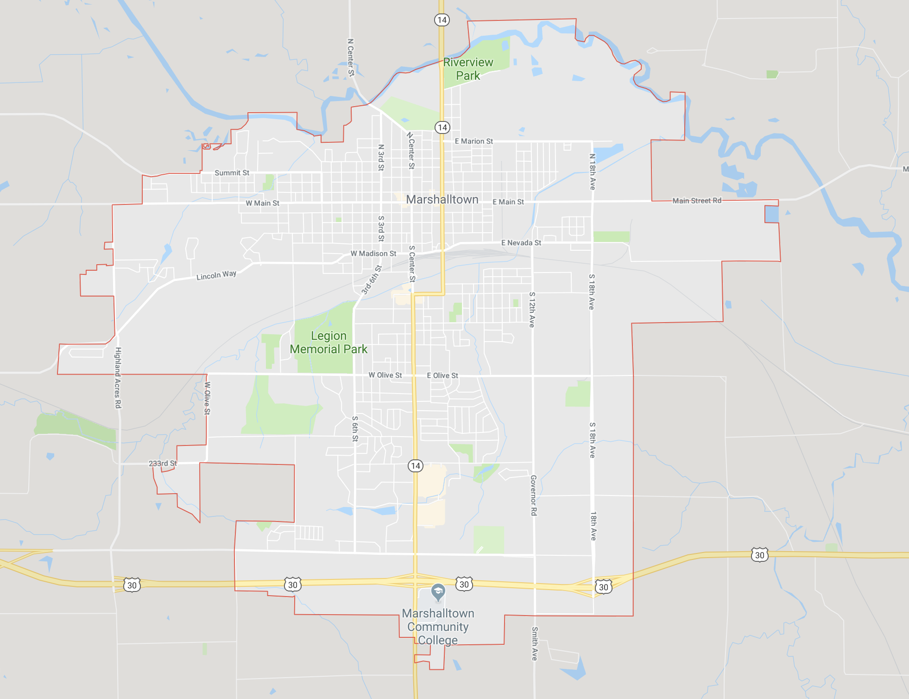
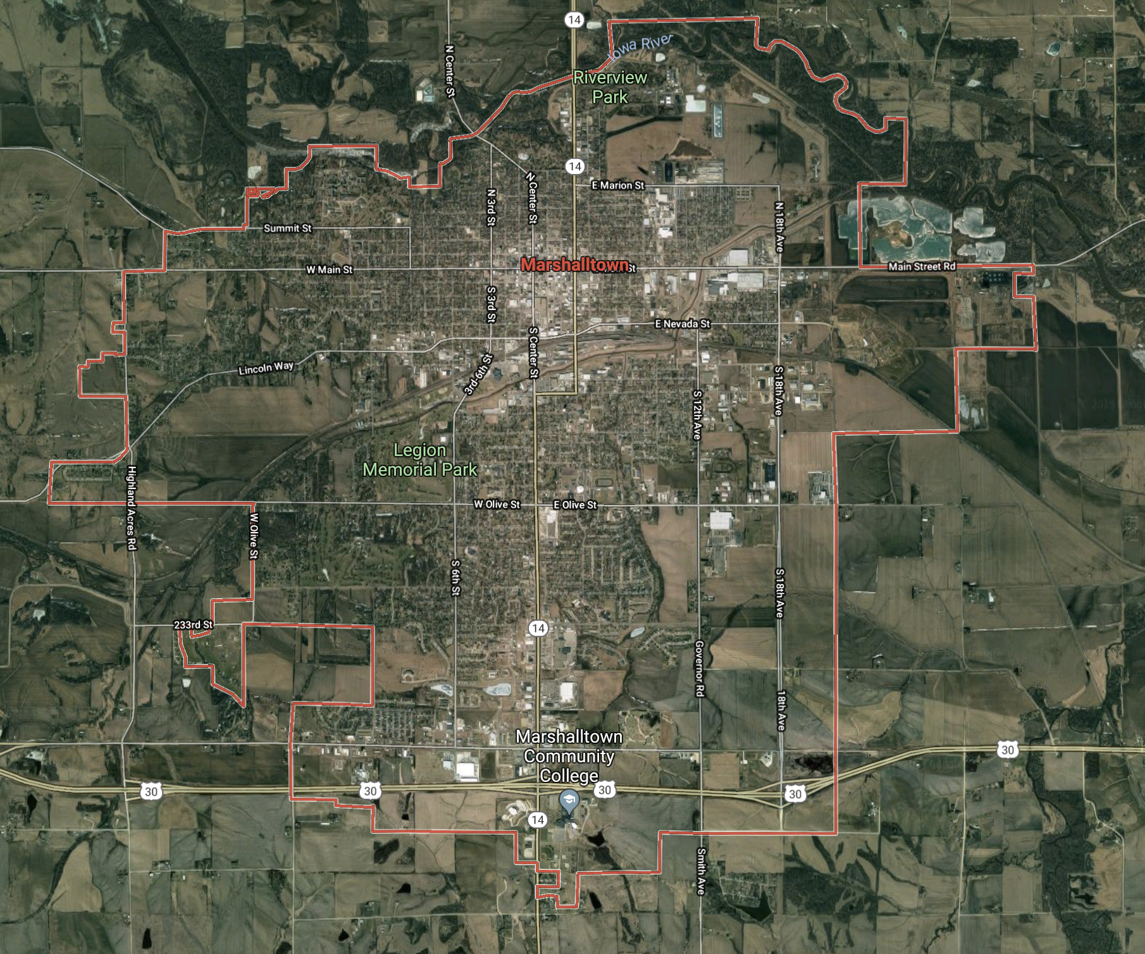
Data Discovery Exercise
Brainstorm Activity
20 minutes – Record ALL ideas!
What information and data would be interesting to address the your project’s problem?
What themes emerge when considering the problem statement?
Goal: Wishlist of dataset ideas that would be informative to the project.
Notes:
At this point, I’d like to pause our presentation and break us up into groups for a data discovery exercise. For this, I want us to step back into our Marshalltown problem. Remembering that we are hoping to think about the transit system in Marshalltown and the changing dynamics at play, I want us to take about 20 minutes to brainstorm the kinds information and data that you would want to bring to bear on the Marshalltown problem. Keep in mind – The SKY IS THE LIMIT! This can be real or imagined datasets from any source.
Logistically, I’d like us all to break into groups of 2-4 people. You have a handout that will help guide you through this exercise.
The sky is the limit!
Information – real or imagined
Data - Designed, Administrative, Opportunity, Procedural
Handout needed
Breakout into groups

Slide 18
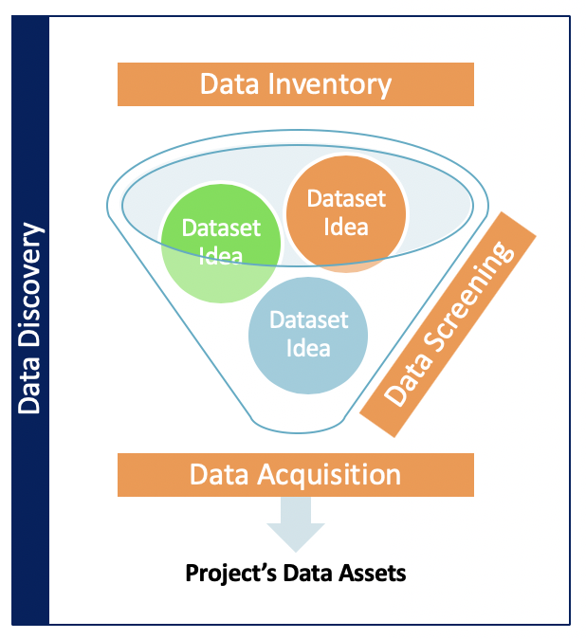
Data Discovery Exercise
Discussion
Domain | Dataset Idea
Notes:
Now that we’ve had some time to think through and research some possible datasets, let’s take a few minutes to discuss the domains and datasets you came up with.
--- discuss + LODES example?
Now that we have our domains and some ideas, I want to pull us up and take a look at where we are. We’ve got our wishlist of datasets, but we’re on a schedule, and we need to make some decisions about which of these we are going to prioritize. The next step is to take this wishlist and figure out a way to quickly thumbs up/thumbs down this list.
-----
IF NOTHING ELSE:
LODES – local employment dataset from CENSUS, could be informative thinking through where people are commuting to
LODES inputs:
UI Wage Records
QCEW
Other Censuses and Surveys
StARS

Slide 19
Which data matches our needs? Example Census Data Inventory
Inventory Questions | Data Source | Keep or Shelve?
Are the data collected opinion-based (e.g., people’s attitudes, preferences, etc.)? | No | Keep
Are the data collection recurring (must be collected at least annually)? | Yes
Are there data available for 2013? | Yes
For Education: Are the data collected at least at the school level? | Yes
For Housing: Are the data collected at the property or housing unit level? | Yes
Can we access the data by August 15th? | Yes
Other concerns? | Yes/No
Notes:
And what we do to make that decision is we come up with a quick list of inventory questions, the highest level of information we need to determine what makes sense for our project.
A lot of this will come out of your project scope and stakeholder conversations.
Our example above relates to a project we did with Census.
The census director came to us with question of “ Are there external data (external to federal statistical system) that could be used to enhance or replace our data?”
For that, we focused on two case studies; ACS Housing & Education questions and review potential external data sources for those data points.
So when we were sifting through our list, we settled on these questions for our wishlist to tdetermine whether the dataset was a good fit.
Examples: State longitudinal systems, etc

Slide 20
Which data matches our needs? Example Census Data Screening
Data | Legal | Ease | Cost | Other
Arl. Co. Property Tax Assessments | MOU | 1 | $0 | Built relationships; open source data
James City County | No | 1 | $0 | Built relationships
BlackKnight | Yes | 1 | $8,250 | No longitudinal editing
CoreLogic | Yes | 2.5 | $7,000 | Confusion over academic portal, separate contract for historical data
MRIS (Arl. Co.) | Yes | 1 | $500 | RBI indemnification clause
MLS (JCC) | - | 1 | $0 | Emailed data once right person found
Location Inc. | Yes | 2 | $19,000 | Neighborhood desirability, proprietary
TransUnion | Yes | 3 | $27,500 | Onsite inspection; 2-part negotiation
Notes:
Just to show you another example of that inventory process, we decided to add a couple questions on the housing side, and you can see cost and legal aspects were brought in. Using county tax assessment data is attractive from a cost perspective, but the legal barriers were a challenge.
BlackKnight & James City – also tax assessment
BlackKnight & CoreLogic – private sector data source - aggregators vs. original source
MRIS – MLS for Arlington County
MLS – for James City County
Location Inc - unusable for this project, opaque in their methods for market advantage - bit of a waste, neighborhood indicators (ex. Walkability) they were either repackaging ACS or something, hard to reconcile

Slide 21
Which data matches our needs? Example Data Screening
Criteria | Community County Business Patterns (Census) | RealtyTrac -> ATTOM
Geographic level | National State County Metropolitan area ZIP Code Congressional District | National State Zip Code Ad-hoc shapes Parcels
Observation Frequency | Annual
Available Years | 1964 - onwards | Clarification needed: up to 4 historical home transactions
Data Access | Separate APIs per year | Bulk license for REST API (JSON & XML)

Slide 22
Which data matches our needs? Example Data Screening
Criteria | Community County Business Patterns (Census) | RealtyTrac -> ATTOM
Geographic level | National State County Metropolitan area ZIP Code Congressional District | National State Zip Code Ad-hoc shapes Parcels
Observation Frequency | Annual
Available Years | 1964 - onwards | Clarification needed: up to 4 historical home transactions
Data Access | Separate APIs per year | Bulk license for REST API (JSON & XML)
Determine whether to keep or throw each dataset. Keep means continue screening. Shelve means document.

Slide 23
Results of Data Inventory
Rural Communities
American Community Survey (Census)
Quarterly Census of Employment and Wages (Bureau of Labor Statistics)
Small Business Administration
Program Impact
RealtyTrac (powered by ATTOM)
ATTOM
CoreLogic
Multiple Listing Service
Community County Business Patterns (Census)
American Housing Survey (Census)
National Establishment Time Series
Zillow / Trulia
Municipality sales data
Texas A&M Real Estate Center - housing activity - sales & volume dollars
Local open data
Broadband
BroadbandUSA.com (National Telecommunications and Information Administration)
National Broadband Map (National Telecommunications and Information Administration)
Form 477 (Federal Communications Commission)
Consumer Technographics® North American Technology, Media, And Telecom Benchmark (Forrester)
Consumer Technographics® North American Online Benchmark Survey, Part 2 and Part 1 (Forrester)
BroadbandNow.com
FiberLocator.com
Notes:
Broadband usa – 200-2012
Before 477
Broadband now = main source

Slide 24
Data Inventory Exercise
Project Problem
1
What information ABOUT the datasets will help you determine their fit with your research?
Notes:
What information do you need about the data to determine its usefulness?
Are there specific characteristics of interest?
Does the problem statement define any constraints?

Slide 25
Data Screening Exercise
Project Problem
1
What information ABOUT the datasets will help you determine their fit with your research?
Notes:
What information do you need about the data to determine its usefulness?
Are there specific characteristics of interest?
Does the problem statement define any constraints?

Slide 26
Inventory Exercise
Brainstorm Activity
10 minutes
Review 2-3 datasets from the discovery exercise using our inventory questions and determine whether to keep or shelve them.
Goal: Inventoried list of data sources with a Keep/Shelve decision.
Notes:
Pick a single data source from the wishlist!
No need to break out – take a source, use computers, come up with and answer the questions

Slide 27
Census Project Data Screening Tool
Purpose | What is the purpose of the organization collecting the data? The Virginia Department of Education coordinates education for the state and makes policy recommendations. Why are the data collected and how does the organization use the data? The data is collected for administrative purposes to assess student and school progress and to inform school policies. Who else uses these data? Businesses, policy-makers, citizens, and researchers use the data. Who do they sell the data to? Zillow sells data to individual homeowners. CoreLogic sells data for multiple uses, such as businesses for economic development and Chief Economists at trade associations
Method | What is the data collection method? The data could be collected via paper questionnaire, operator entry, online surveys, interviews, sensors, scraping methods. What is the type of data collected? Designed, observation, administrative, digital, etc. If designed, who created the questions? Government, researchers, private businesses? What are the raw sources of the collected data prior to any aggregation? Self-report, third-party?
Description | What is the general topic of the data? Student learning, housing quality? What are the earliest and latest dates for which data are available? 1995-2005
Timeliness | Are the data collected and available periodically? Annual? Diennial? How soon after a reference period ends can a data source be prepared and provided? A year?
Selectivity | What is the universe that the data represents? Population/sample? Students who attended public school in Virginia in 1995?
Accessibility | How are the data accessed? API, FTP? Are they open data? Any legal, regulatory, or administrative restrictions on accessing the data source? Cost? Is it one-time or annual or project-based payment? Are there any gaps or concerns with this dataset?

Slide 28
Broadband Project Data Screening Tool
 | Phase 1
Purpose | What is the purpose of the organization collecting the data? Why are the data collected and how does the organization use the data? Who else uses these data? Who do they sell the data to?
Method | What is the data collection method? What is the type of data collected? If designed, who created the questions? What are the raw sources of the collected data prior to any aggregation?
Description | What is the general topic of the data? What are the earliest and latest dates for which data are available?
Timeliness | Are the data collected and available periodically? How soon after a reference period ends can a data source be prepared and provided?
Selectivity | What is the universe (e.g., population) that the data represents?
Accessibility | How are the data accessed? Are they open data? Any legal, regulatory, or administrative restrictions on accessing the data source? Cost? Is it one-time or annual or project-based payment?

Slide 29
Broadband Project Data Screening Tools
 | Phase 2
Description | What is the temporal nature of the data: longitudinal, time-series, or one time point? Are the data geospatial? If Yes, at what level, (e.g. census tracts, coordinates)?
Selectivity | What unit is represented at the record level of the data source? Does this universe match the stated intentions for the data collection? If not, what has been included or excluded and why? What is the sampling technique used? What is the coverage, (e.g. response rate)?
Accessibility | Are any records or fields collected, but not included in data source, such as for confidentiality reasons? Is there a subset of variables and/or data that must be obtained through a separate process? If yes, is there a separate legal, regulatory, or administrative restrictions on accessing the data source?
Metadata | Is there information available to assess the transparency and soundness of the methods to gather the data for our purposes? Is there a description of each variable in the source along with their valid values? Are there unique IDs for unique elements that can be used for linking data? Is there a data dictionary or codebook?
Stability/ coherence | Were there any changes to the universe of data being captured (including geographical areas covered) and if so what were they? Were there any changes in the data capture method and if so what were they? Were there any changes in the sources of data and if so what were they?
Accuracy | Are there any known sources of error? Describe any quality control checks performed by the data’s owner?
Privacy and security | Was consent given by participant? If so, how was consent given? Are there legal limitations or restrictions on the use of the data? (does it contain PHI/PII? NPI?) What confidentiality policies are in place?
Research | What research has been done with this dataset? Include any links to research if provided. List any other data use notes provided by the supplier.

Slide 30
Screening Exercise
Brainstorm Activity
What information do you need about the data to determine its usefulness?
Goal: Exhaustive list of questions about the data, tested against a data source.
Email your list & data source example to dnair@virginia.edu by 1:30 pm!
Notes:
Pick a single data source from the wishlist!
12:30 – working lunch! Come up with your own extensive screening tool.
By this point:
Data List - flex this based on how long slides
Datalist to inventory – 15 min
Described data screening
90 minutes for lunch
1 pm – Reconvene to build out recommendations for first acquisitions
2:15 break
Do screening example with Aaron’s transit example

Slide 31
Data Discovery Exercise
Marshalltown Transit Problem
1
What themes emerge from problem elaboration? | Who is engaged in or impacted by this work? | What internal or external factors affect this space? | What is the desired outcome of this research? A decision? An action?
Are any patterns emerging? Do these give rise to informational domains?

Slide 32

Data Discovery Exercise
Project Problem
2
What informational domains at play? What are your levels of analysis? What potential data sources are out there to help address these domains?
Domain: Community
Domain:
Age distribution
Education distribution
Income/wealth indicators
Racial/ethnic composition
Domain:
Domain:
Domain:

Slide 33
Data Map
Marshalltown Transit Problem
3
Infrastructure
Schools
Districts
School Attendance Zones
Parks
Real Estate Market
Zoning
Active Rentals
Parcel-specific Tax Data
Residences needing Assistance
Address Points
Roads
Flood Zones
City Limits
Transit
Bus Routes
Individual Bus Data
Seasonal Miles
Route Miles
Revenue Miles
Dialysis Miles
Deadhead Miles
Hours Run
Bus Ridership Data
Total Riders by Day
Customer report
Sporadic rider counts
Walkability Study
Community
Census
Decennial Census
ACS
Disability
Health Facilities
Food Stamps
Local Economy
Business Locations (Sales Genie)
Local Employment
Domain
Domain
Domain

Slide 34
Data Inventory Exercise
Marshalltown Transit Problem
1
Inventory Question | Datasets

Slide 35
Data Screening Exercise
Marshalltown Transit Problem
1
What information ABOUT the datasets will help you determine their fit with your research?

